Slide 1




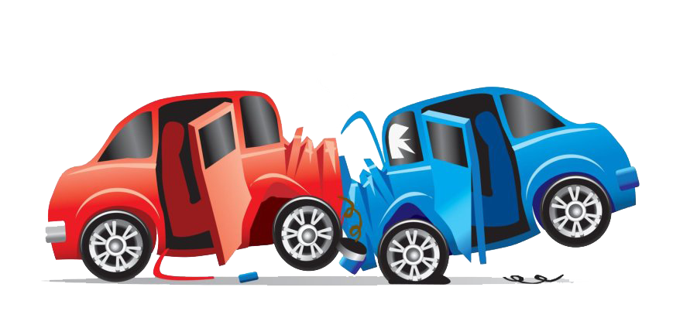
Phoenix Metropolitan Traffic Accident Analysis
ASU DATA ANALYTICS & VISUALIZATIONS
SSS
STREET SAFETY SQUAD
Team Members
Kenway, Ritika, Tiffany & Walter
June 10, 2024
This Photo by Unknown Author is licensed under CC BY-NC
Notes:
Kenway

Slide 2

ASU DATA ANALYTICS & VISUALIZATIONS
SSS
OVERVIEW
STREET SAFETY SQUAD
The goal of this project is to analyze traffic accidents in the Metro Phoenix area to identify high-risk areas and determine the factors influencing accident volume and severity.
Machine learning techniques will be utilized to predict future accidents and create visualizations to compare accident rates and severity across various time periods and conditions within the Phoenix Metropolitan area.
The final deliverables will include an interactive map, comprehensive comparative analysis, and detailed documentation of findings and recommendations. These will help city planners and policymakers improve road safety by identifying high-risk areas and potential causes of accidents.
This Photo by Unknown Author is licensed under CC BY-SA
Notes:
Kenway

Slide 3
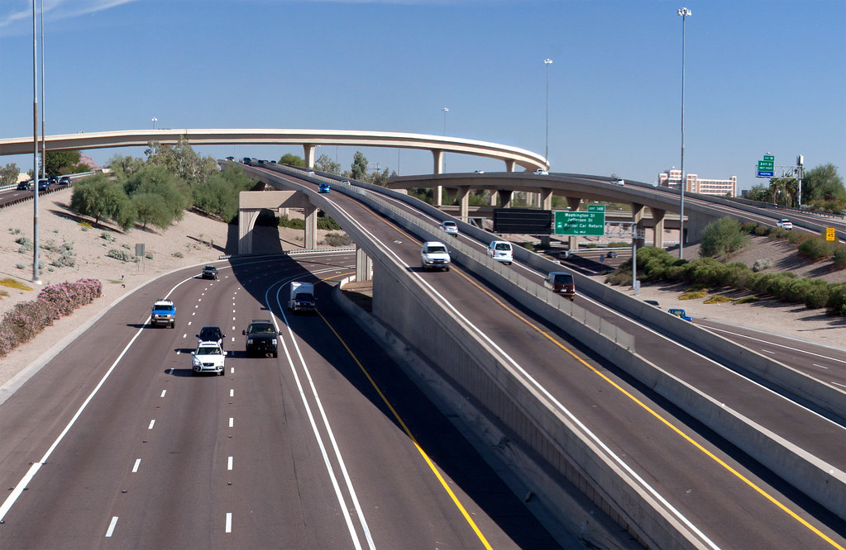
ASU DATA ANALYTICS & VISUALIZATIONS
SSS
OBJECTIVE
STREET SAFETY SQUAD
Identify and Analyze Traffic Issues in Metro Phoenix
Key Question: What are the primary factors influencing traffic accidents in Metro Phoenix, and how do seasonal weather patterns, particularly the monsoon season, affect accident frequency and severity?
Sub-Questions:
Which areas in Metro Phoenix are most prone to accidents?
Which city experiences the highest volume of accidents?
Which city has the most severe accidents in terms of traffic impact?
How does weather, particularly during the monsoon season, affect the volume of accidents?
This Photo by Unknown author is licensed under CC BY-SA.
Notes:
Tiffany- severity is the impact the accident had on traffic not injury per data set

Slide 4

ASU DATA ANALYTICS & VISUALIZATIONS
SSS
IDEATION & DATASET
STREET SAFETY SQUAD
Ideation
As a team, we chose to investigate traffic accidents with a focus on Arizona, narrowing down further to the Phoenix Metro area since it is our place of residence. This localized focus was influenced by the complexities and size of the dataset, leading us to work with subsets that still provided sufficient data for meaningful analysis.
Dataset
US Traffic Accident Data
Primary Source: Kaggle
Tools Used
Data Manipulation: Python Pandas, NumPy
Visualization: Python Matplotlib, Plotly, Tableau
Database: PostgreSQL
Machine Learning: Scikit-learn
Data Handling:
The original dataset contained 7 million entries.
Used subset dataset composed of 500,000 entries
This Photo by Unknown author is licensed under CC BY-SA-NC.
Notes:
Ritika

Slide 5
DATA CLEANING & ENGINEERING
ASU DATA ANALYTICS & VISUALIZATIONS
SSS
STREET SAFETY SQUAD
This Photo by Unknown Author is licensed under CC BY-NC
Notes:
Walter

Slide 6
ASU DATA ANALYTICS & VISUALIZATIONS
SSS
DATA CLEANING
STREET SAFETY SQUAD
Initial Dataset:
US accident reports (2016-2023)
Over 7 million entries, 46 columns
Issues: runtime errors, program crashes, upload/download problems due to file size
Subset Dataset:
500,000 entries
Resolved previous issues for easier management and processing on GitHub
Adjusted to include only Arizona accidents
Final Dataset:
Focused on 2022 data (most complete year)
Adjustments made:
Changed datatypes
Dropped irrelevant columns
Renamed columns for readability
Filtered for 2022 accidents in Phoenix metro area
Addressed NaN values
Saved cleaned data to a new CSV for analysis and PostgreSQL database creation
Notes:
Walter

Slide 7
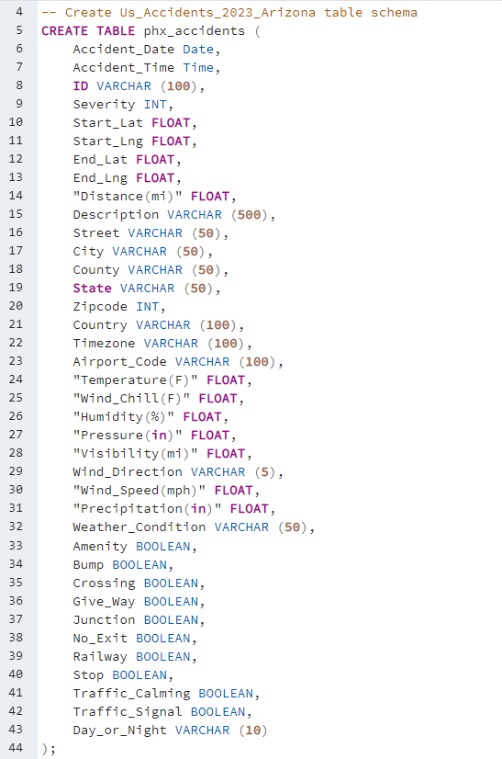
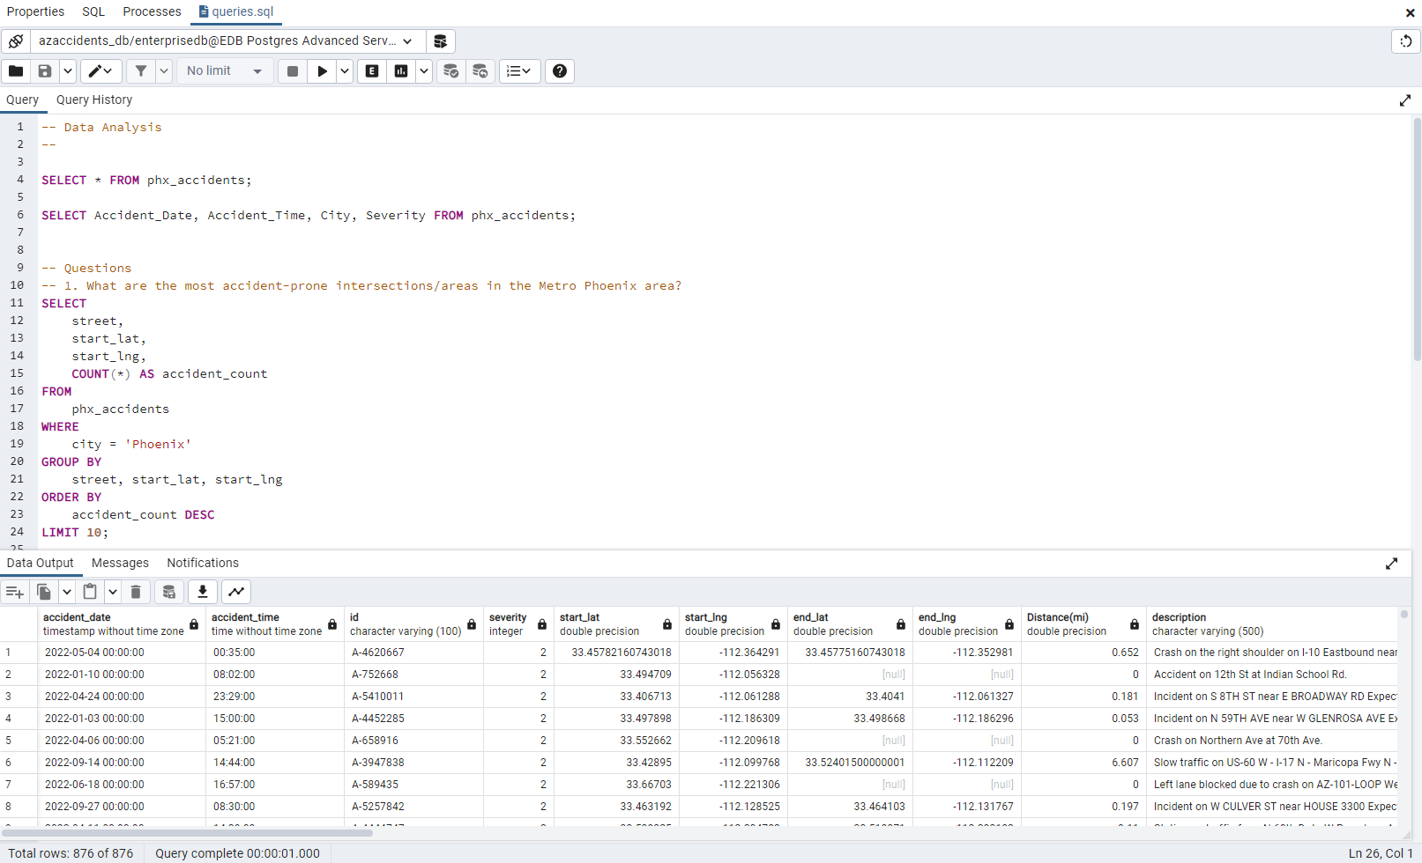
ASU DATA ANALYTICS & VISUALIZATIONS
SSS
DATABASE
STREET SAFETY SQUAD
PostgreSQL Database
Notes:
Tiffany

Slide 8
EXPLORATION & VISUALIZATIONS
ASU DATA ANALYTICS & VISUALIZATIONS
SSS
STREET SAFETY SQUAD
This Photo by Unknown Author is licensed under CC BY-NC
Notes:
Kenway

Slide 9
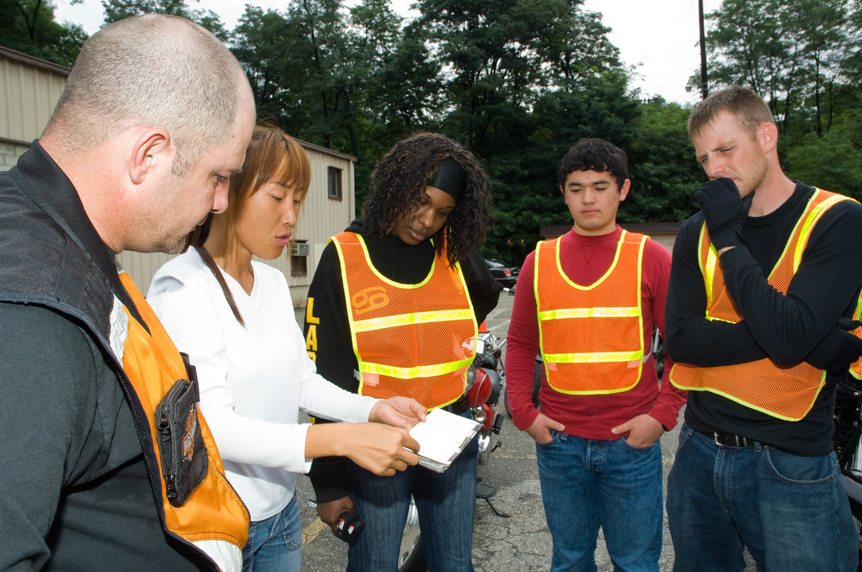
ASU DATA ANALYTICS & VISUALIZATIONS
SSS
DATA EXPLORATION
STREET SAFETY SQUAD
This section will address the key questions from our objectives through thorough data exploration and visualizations. Additionally, it will highlight other interesting insights discovered during the exploration process.
This Photo by Unknown author is licensed under CC BY-SA-NC.
Notes:
Kenway

Slide 10
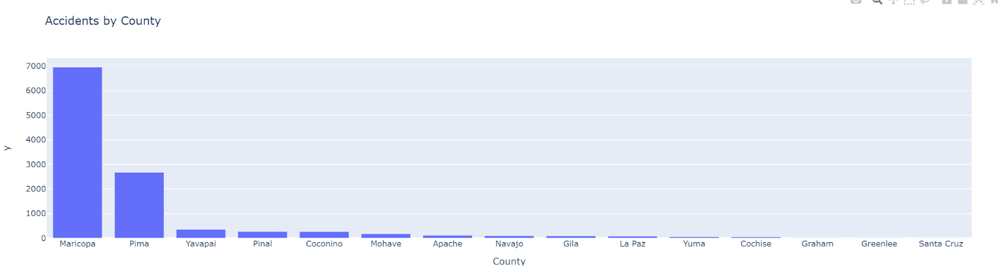
ASU DATA ANALYTICS & VISUALIZATIONS
SSS
COUNTY COUNT
STREET SAFETY SQUAD
The county count was conducted using the initial dataset, which included all accidents in Arizona. Phoenix Metro is specifically located within Maricopa County.
Notes:
Ritika

Slide 11
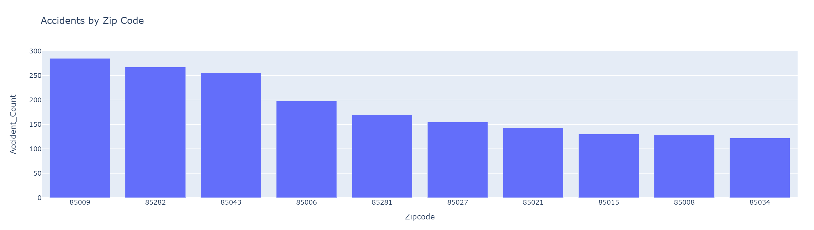
ASU DATA ANALYTICS & VISUALIZATIONS
SSS
ZIPCODE COMPARISON
STREET SAFETY SQUAD
Notes:
Ritika

Slide 12
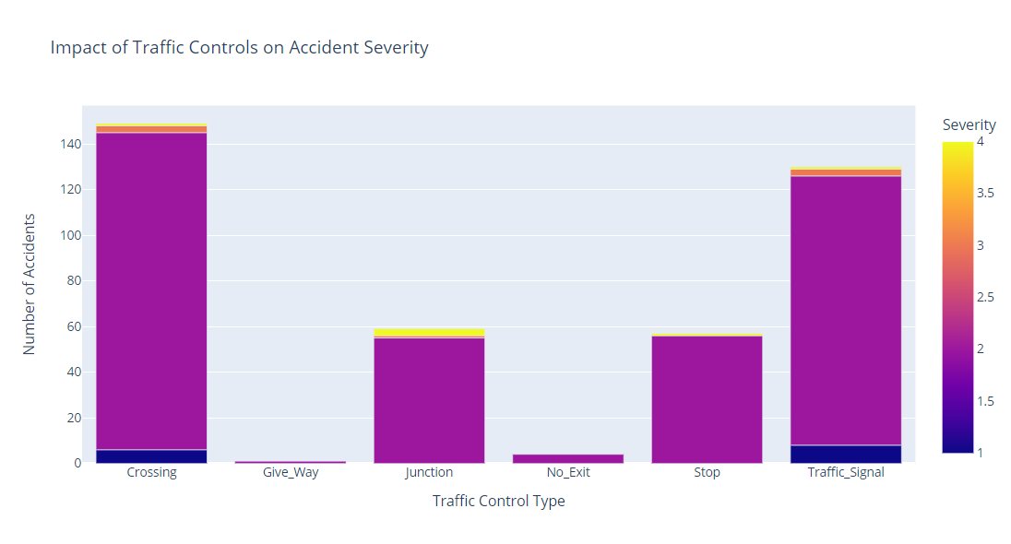
ASU DATA ANALYTICS & VISUALIZATIONS
SSS
TRAFFIC CONTROLS
STREET SAFETY SQUAD
Notes:
Ritika

Slide 13
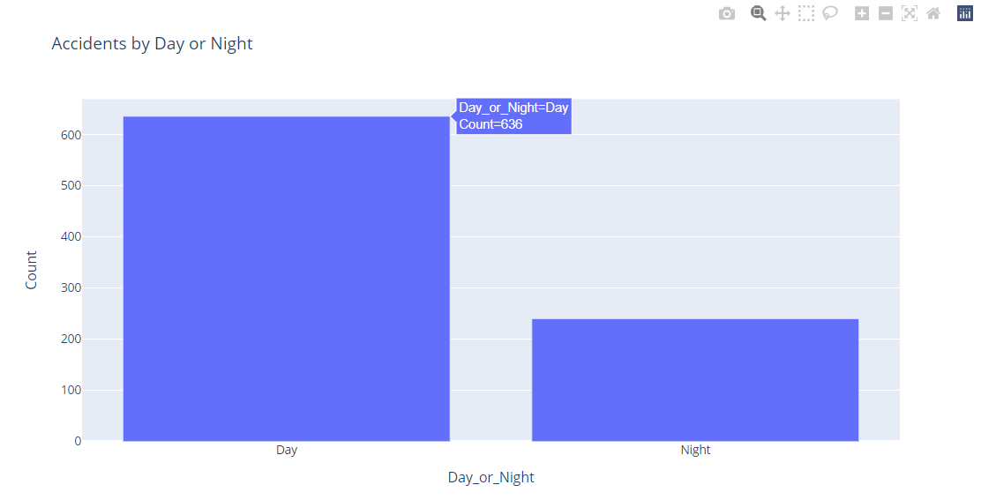
ASU DATA ANALYTICS & VISUALIZATIONS
SSS
TRENDS
STREET SAFETY SQUAD
Notes:
Tiffany- per our dataset, Shows the period of day (i.e. day or night) based on sunrise/sunset. So, about 73% of accidents occur in the day time

Slide 14
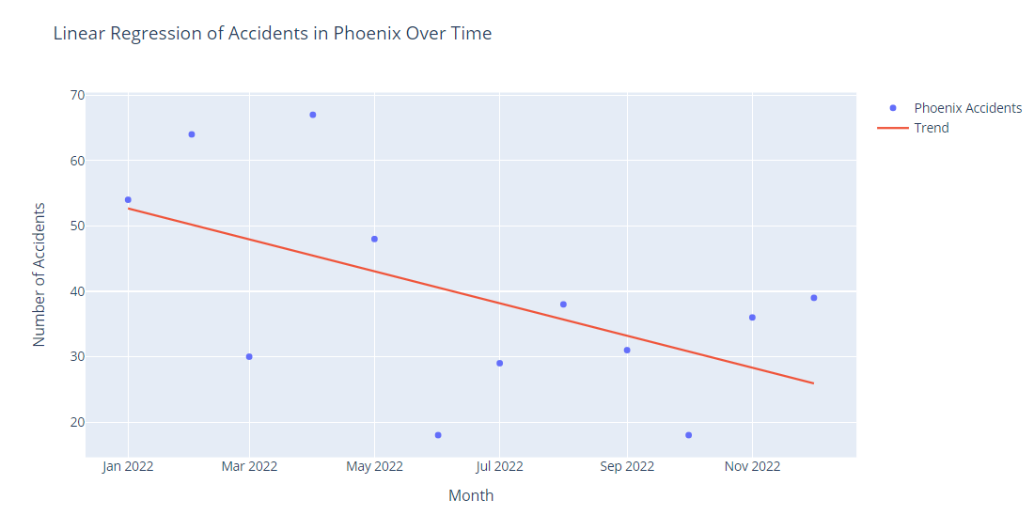
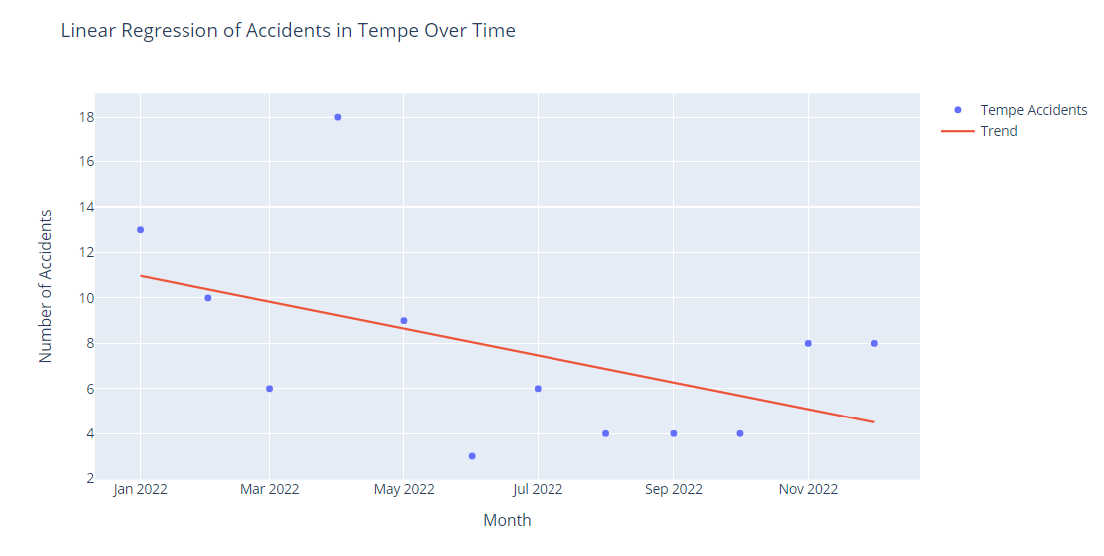
ASU DATA ANALYTICS & VISUALIZATIONS
SSS
TRENDS
STREET SAFETY SQUAD
Correlation Coefficient(r): -0.5459661323023076
Correlation Coefficient(r): -0.4863772126858657
A Moderate Negative Correlations was found between the Month/Year and # of Accidents
Notes:
Tiffany- 2 cities in the phx metro area with largest volume of accidents (Phx, Tempe) and wanted to see if there was a correlation between the time of year and accidents.

Slide 15
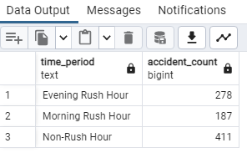
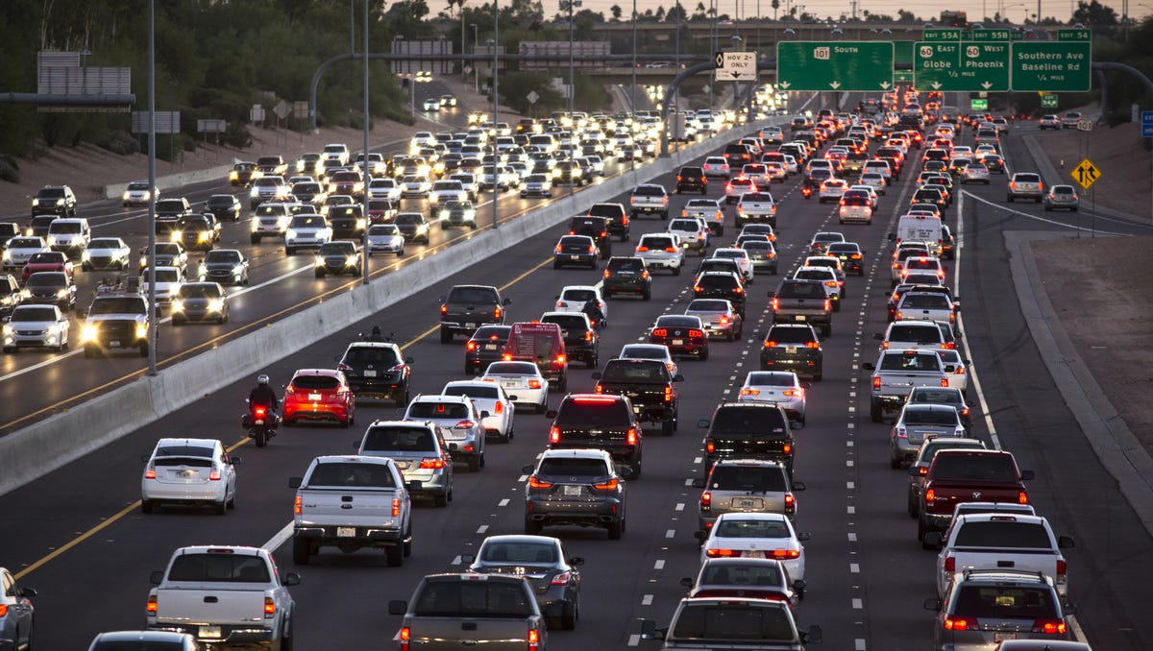
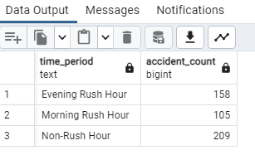
ASU DATA ANALYTICS & VISUALIZATIONS
SSS
TRENDS
STREET SAFETY SQUAD
Phoenix Metro Rush Hour
The probability of getting into an accident during rush hour is approximately 53.1%.
The probability of getting into an accident during non-rush hour times is approximately 46.9%.
Phoenix City Rush Hour
The probability of getting into an accident during rush hour is approximately 55.7%.
The probability of getting into an accident during non-rush hour times is approximately 44.3%.
Notes:
Tiffany

Slide 16
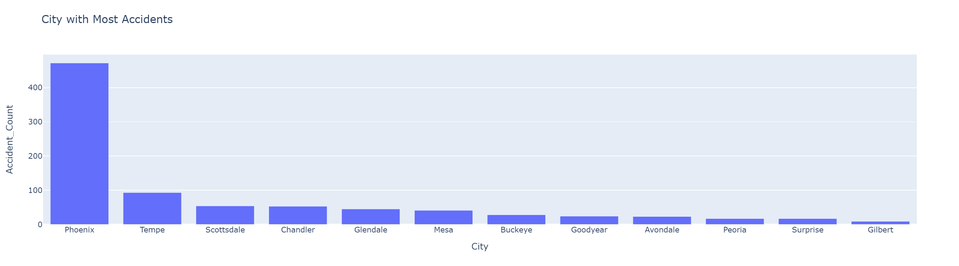
ASU DATA ANALYTICS & VISUALIZATIONS
SSS
CITY COUNT
STREET SAFETY SQUAD
Which city experiences the highest volume of accidents?
Phoenix has the most accidents with approximately 460 accidents.
Notes:
Kenway- This is the slide where we transition into answering our questions

Slide 17
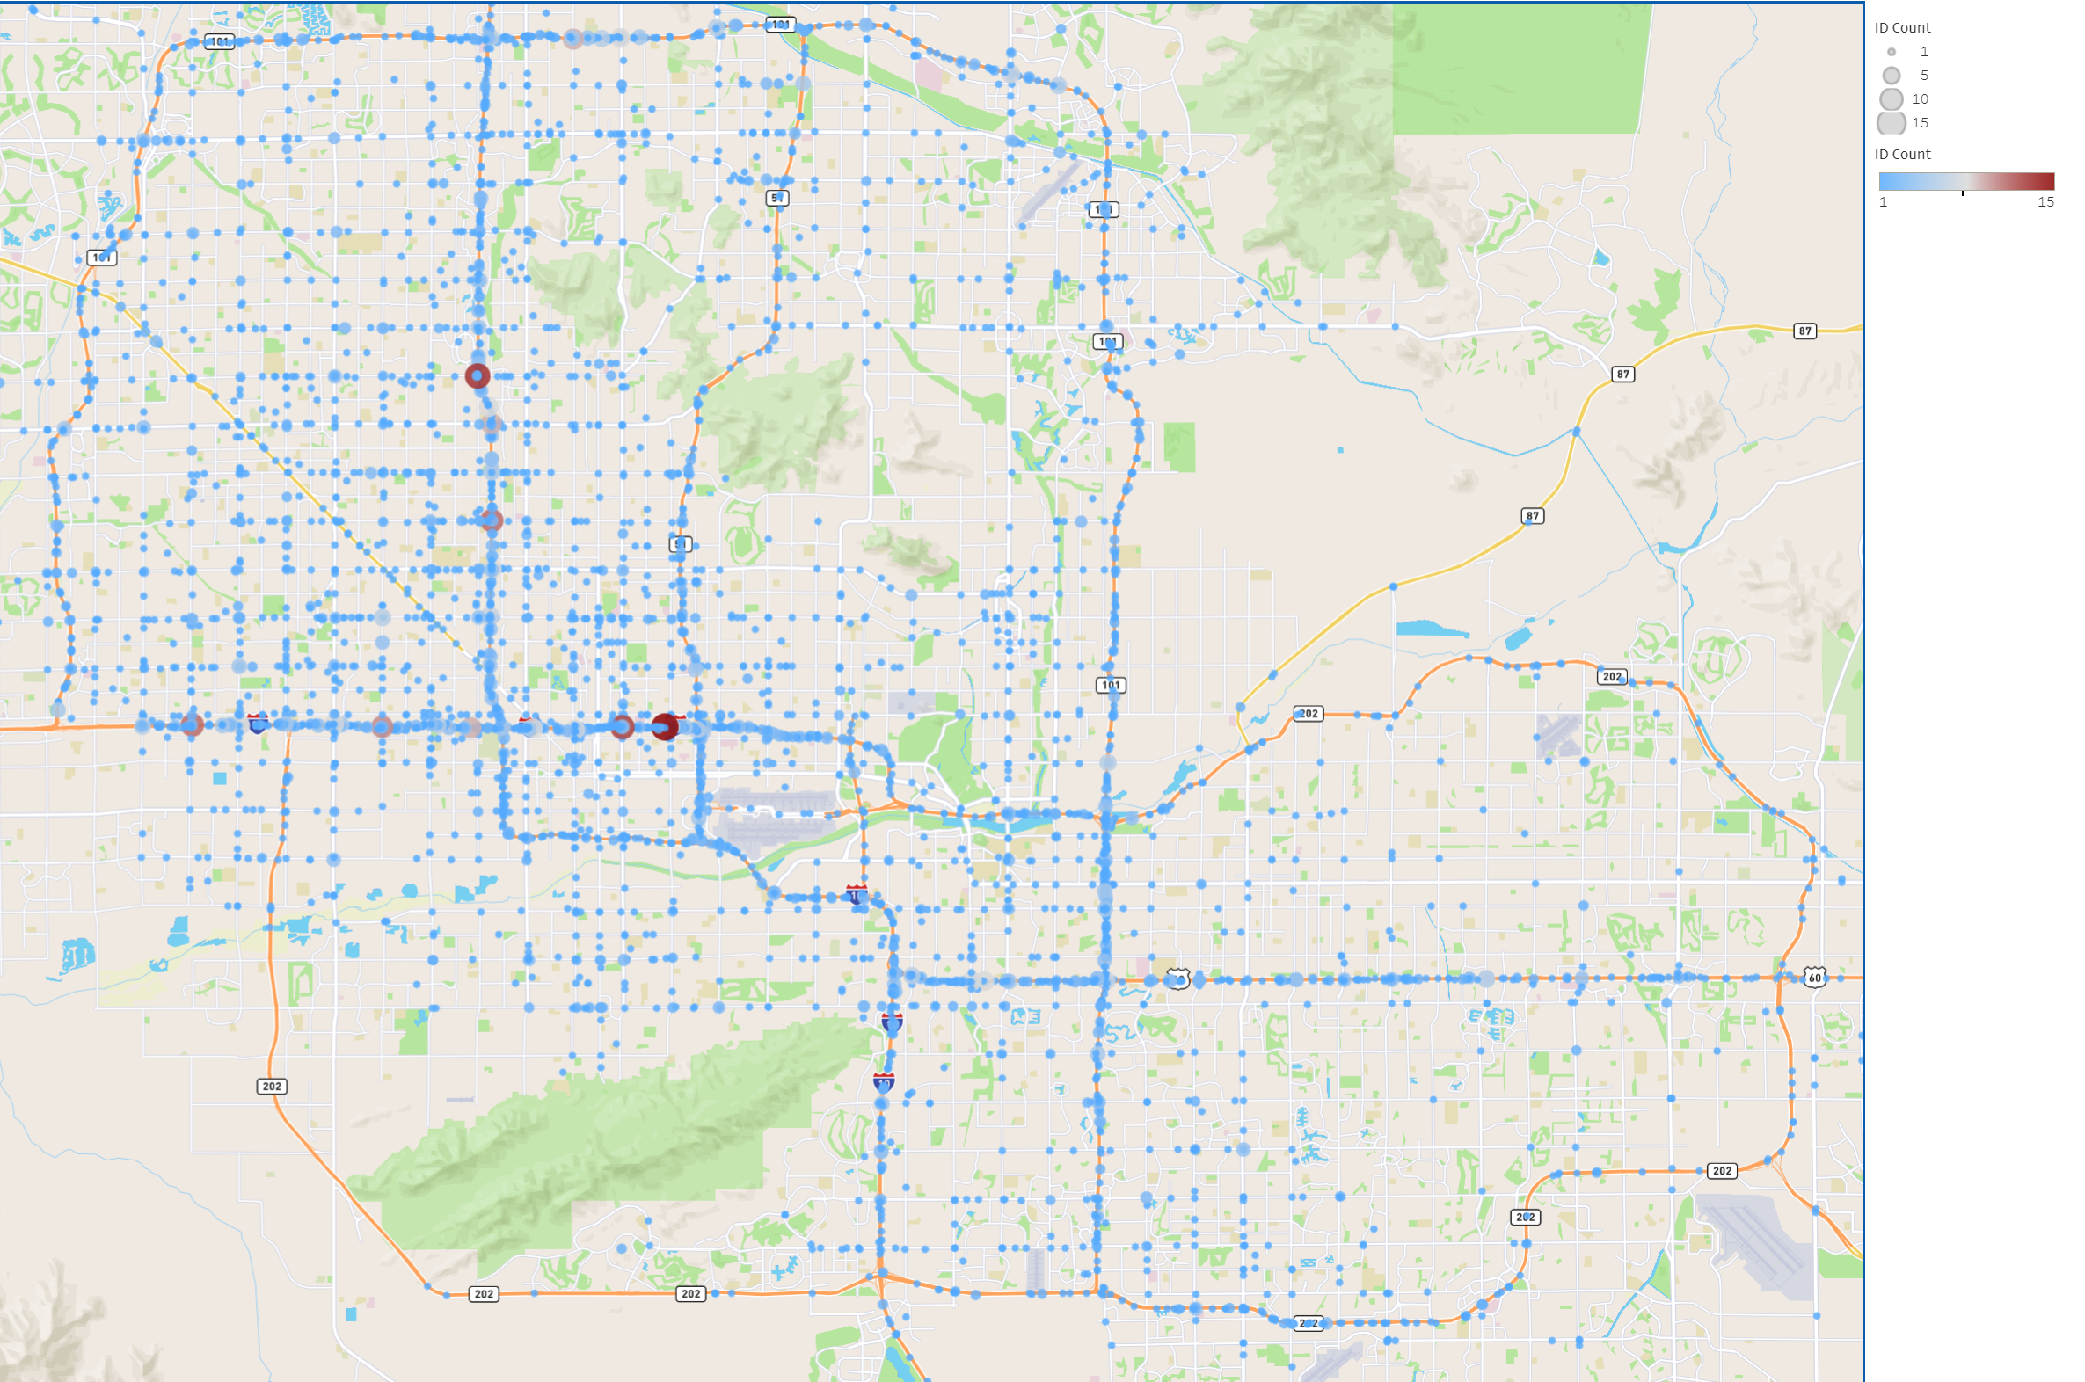
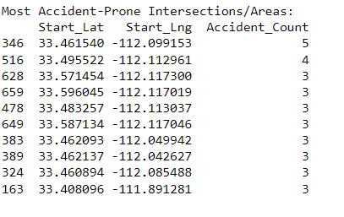
ASU DATA ANALYTICS & VISUALIZATIONS
SSS
PHOENIX METRO MAP
STREET SAFETY SQUAD
Which areas in Metro Phoenix are most prone to accidents?
Tableau Map Link
Notes:
Kenway

Slide 18
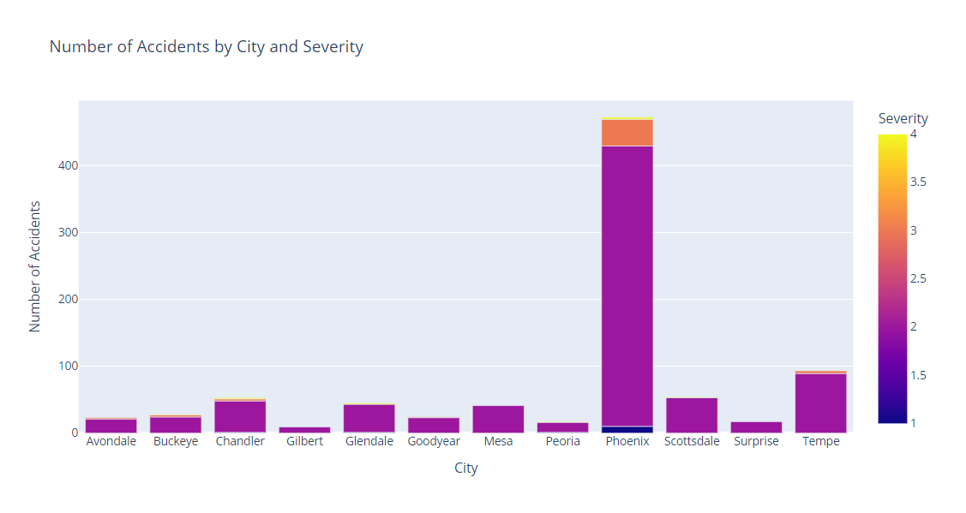
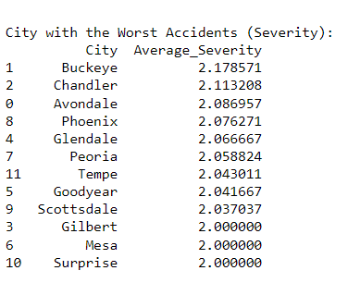
ASU DATA ANALYTICS & VISUALIZATIONS
SSS
DATA EXPLORATION
STREET SAFETY SQUAD
Which city has the most severe accidents in terms of traffic impact?
​Buckeye has the most severe accidents; the average severity is 2.178
Note: "Severity is primarily defined based on the impact on traffic flow, rather than the incident itself."
Sobhan Moosavi (dataset Creator)
Notes:
Kenway

Slide 19
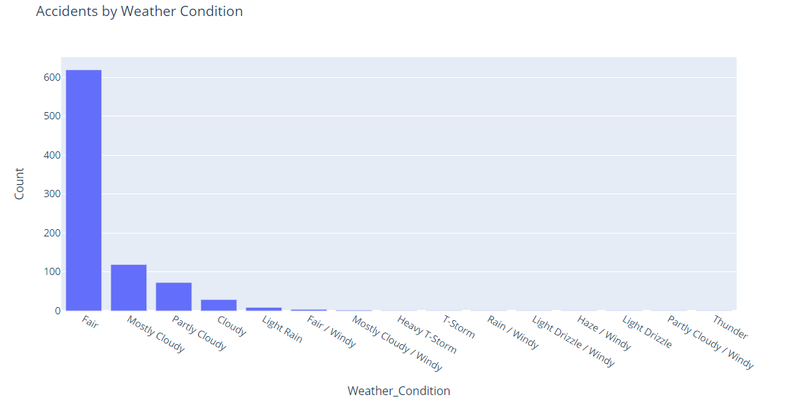
ASU DATA ANALYTICS & VISUALIZATIONS
SSS
WEATHER CONDITION
STREET SAFETY SQUAD
Does weather condition impact the volume of accidents?
Per AzFamily.com, Phoenix sees about 300 sunny days per year
Notes:
Ritika
This slide shows the Weather condition. When the weather is fair, there are approximately 605 accidents. When it is mostly cloudy, there are 105 accidents on the road. When it is partly cloudy, there are about 80 accidents. When the weather is cloudy, there are approximately 20 accidents, when there is light rain, there are about 7 accidents. When it is fair or windy, there are approximately 4 accidents on the road. When it is mostly cloudy or windy, there are 3 accidents. There are not many accidents happening in Heavy T-storm weather. When there is a Heavy T-storm, T-storm, or it is rainy or windy, there are not many accidents happening. When there is light drizzle or windy, there are no accidents happening. There are approximately no accidents when the weather is hazy/windy weather, or there is a light drizzle. There are approximately no accidents happening when it is partly cloudy/windy and the same is true when it is thundering.

Slide 20
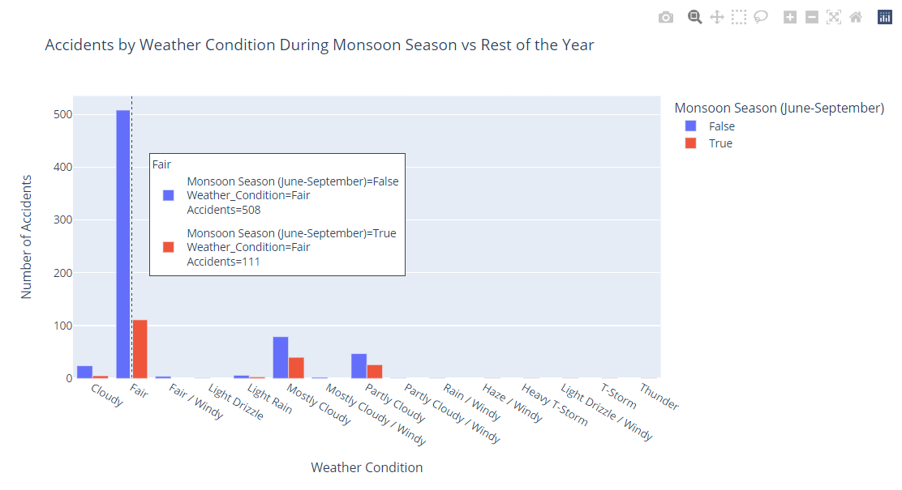
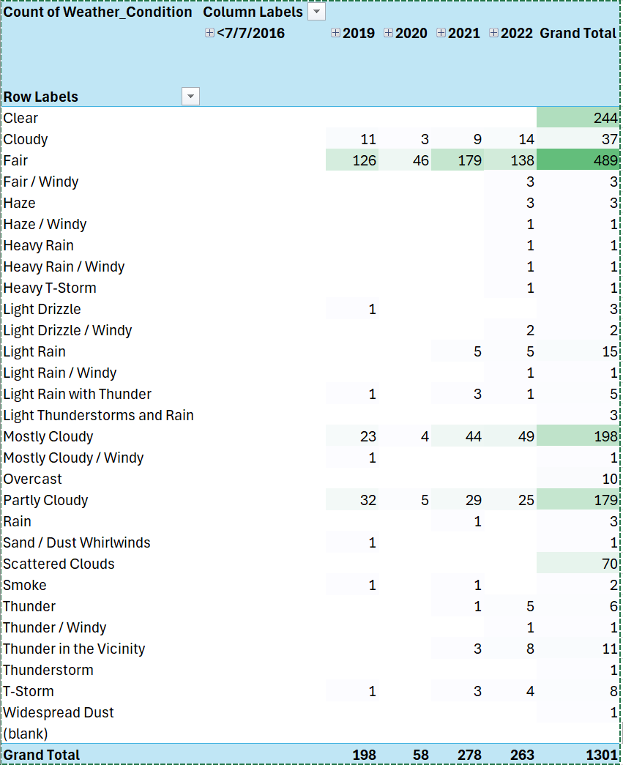
ASU DATA ANALYTICS & VISUALIZATIONS
SSS
MONSOON SEASON
STREET SAFETY SQUAD
The data does not support that the Monsoon season (July-September) has a negative affect the number of ​traffic accidents vs the rest of the year.
Notes:
Ritika
The slide shows the graph of the Accidents by weather condition during the monsoon season vs the rest of the year. The 2nd image shows the count of the weather condition and the column labels for the years 2019, 2020, 2021, 2022 and the Grand total.

Slide 21
ASU DATA ANALYTICS & VISUALIZATIONS
SSS
DATA INTERPRETATION
STREET SAFETY SQUAD
Key Findings:
High Accident Rates: Notable in Phoenix and major highways.
Impact Levels: Most accidents have a moderate impact on traffic (Level 2).
Patterns and Trends:
Peak Times: Accidents are most frequent during rush hours and daytime, particularly in clear weather.
Severity: Higher severity accidents are common in Phoenix, especially on highways.
Insights and Implications:
Traffic Signals and Crossings: Frequent accidents at these locations may require infrastructure evaluation and redesign.
Targeted Interventions: Specific high-severity areas need focused attention and improvements.
Recommendations:
Infrastructure Improvements: Enhance safety measures in high-severity accident zones.
Further Research: Investigate other factors affecting drivers, especially since most accidents occur in clear weather.
This Photo by Unknown author is licensed under CC BY-SA.
Notes:
Tiffany

Slide 22
MACHINE LEARNING
ASU DATA ANALYTICS & VISUALIZATIONS
SSS
STREET SAFETY SQUAD
This Photo by Unknown Author is licensed under CC BY-NC
Notes:
Tiffany

Slide 23
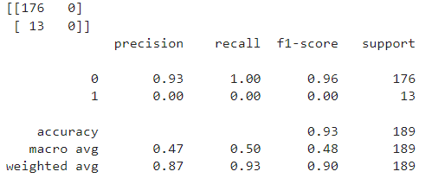
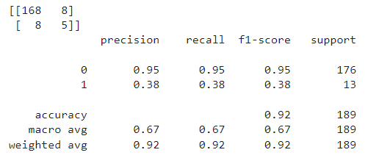
ASU DATA ANALYTICS & VISUALIZATIONS
SSS
BUILDING & TESTING
STREET SAFETY SQUAD
Initial Logistic Regression Model
SMOTE & Retrain Logistic Regression
During the initial logistic regression analysis, it was observed that the low number of high-severity accident data points resulted in inaccurate predictions
To address the issue, SMOTE was applied to generate dummy data points.
Although this approach slightly improved the model, the enhancements were minimal and unsatisfactory
Traffic Severity Impact 1 & 2 (low-severity) = Class 0
Traffic Severity Impact 3 & 4 (high-severity) = Class 1
Notes:
Walter

Slide 24
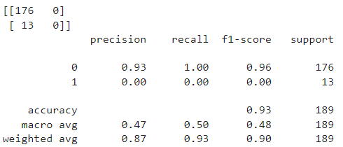
Feature Selection with RandomForest & Retrain Model
ASU DATA ANALYTICS & VISUALIZATIONS
SSS
BUILDING & TESTING
STREET SAFETY SQUAD
Additional research identified the RandomForest model, utilizing the statistical technique of 'bagging,' designed to handle scenarios like this.
Notes:
Walter

Slide 25
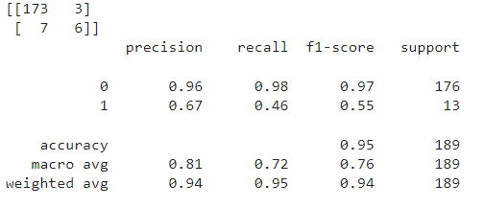
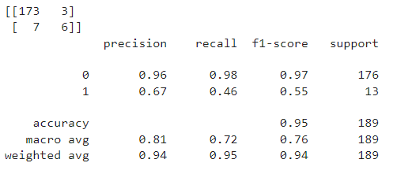
ASU DATA ANALYTICS & VISUALIZATIONS
SSS
BUILDING & TESTING
STREET SAFETY SQUAD
Train XGBoost Classifier
Recalculate scale_pos_weight &
Retrain XGBoost
XGBoosting (Extreme Gradient Boosting) was implemented to rebalance classifications.
Recalculated scales to attempt to improve model performance.
Notes:
Walter

Slide 26
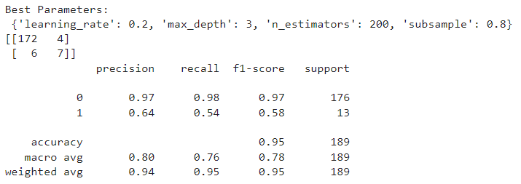
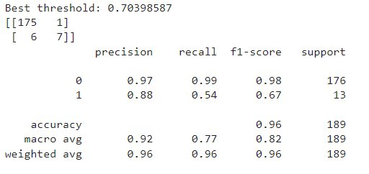
ASU DATA ANALYTICS & VISUALIZATIONS
SSS
BUILDING & TESTING
STREET SAFETY SQUAD
Perform Grid Search for Hyperparameter Tuning
Adjust Predictions Based on Best Threshold
We then had it adjust based on the best thresholds. This gave us a model that was satisfactory, albeit not a good model for the minority class.
Optimized hyperparameters for best performance
Notes:
Walter

Slide 27
ASU DATA ANALYTICS & VISUALIZATIONS
SSS
FINDINGS
STREET SAFETY SQUAD
Model Accuracy
Overall accuracy is 96%. While high, this can be misleading with imbalanced datasets.
Performance for Class 0
This model performs very well in predicting the majority class.
Precision: 0.97 (97%)
Recall: 0.99 (99%)
F1-Score: 0.98 (98%)
Performance for Class 1
This model struggles with the minority class, especially in recall and F1-score, indicating difficulty in identifying these instances.
Precision: 0.88 (88%)
Recall: 0.54 (54%)
F1-Score: 0.67 (67%)
​
Traffic Severity Impact 1 & 2 (low-severity) = Class 0​
Traffic Severity Impact 3 & 4 (high-severity) = Class 1​
Notes:
Walter

Slide 28
ASU DATA ANALYTICS & VISUALIZATIONS
SSS
FINDINGS
STREET SAFETY SQUAD
Confusion Matrix
The model correctly identifies most class 0 instances but misses several class 1 instances.
Macro and Weighted Averages
Macro averages provide a balanced view, indicating decent overall performance. Weighted averages reflect the model's strong performance for the majority class.
Notes:
Walter

Slide 29
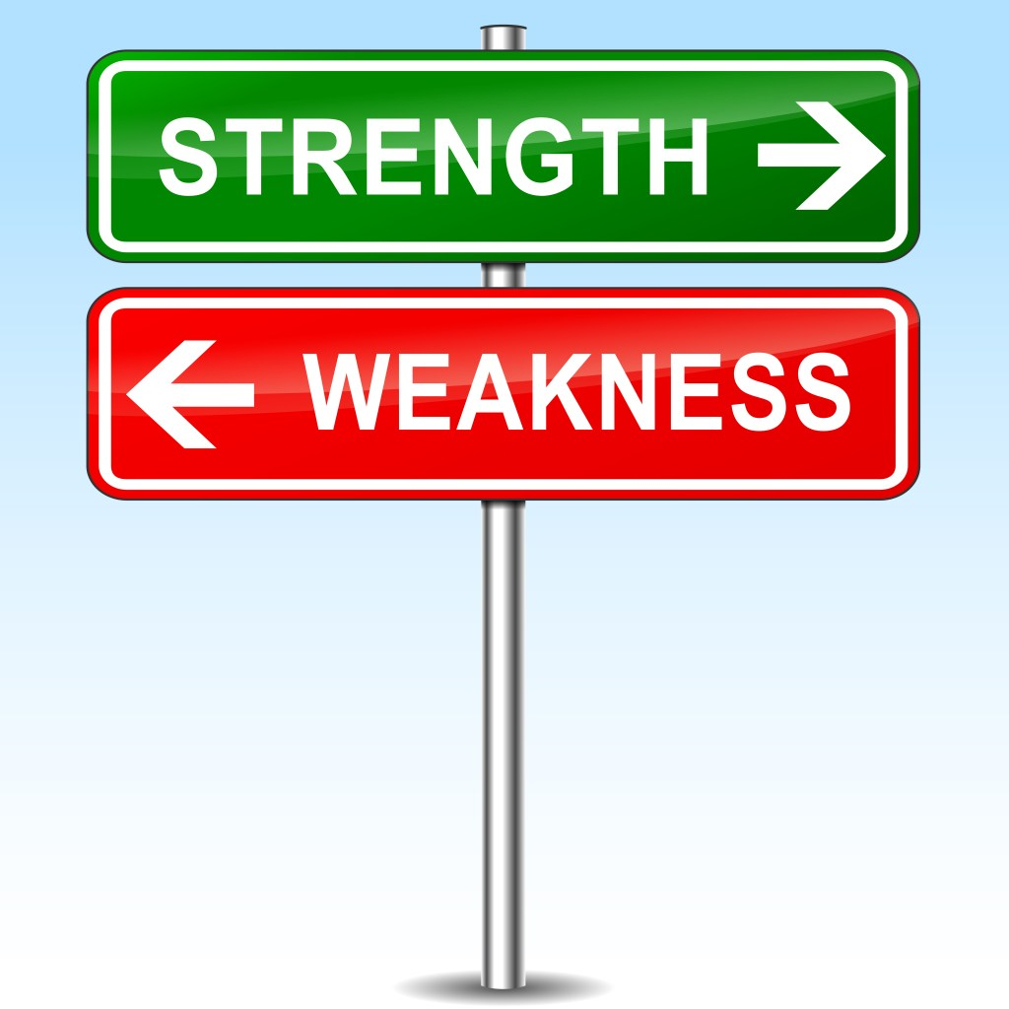
ASU DATA ANALYTICS & VISUALIZATIONS
SSS
CLOSING SUMMARY
STREET SAFETY SQUAD
Strengths:
Excellent at predicting the majority class.
High overall accuracy.
Weaknesses:
Struggles with predicting the minority class.
Imbalanced dataset with fewer high-severity accidents (Class 1) negative affects model accuracy.
This Photo by Unknown author is licensed under CC BY-NC-ND.
Notes:
Kenway

Slide 30

ASU DATA ANALYTICS & VISUALIZATIONS
SSS
CLOSING SUMMARY
STREET SAFETY SQUAD
Key Takeaways and Recommendations
Balanced datasets are crucial for accurate results in supervised machine learning. Imbalances can lead to models that perform well on the majority class but poorly on the minority class, which can be critical in certain applications.
A subset dataset was used for this analysis. Results could vary if more data, particularly for accidents classified under Class 1 with traffic impact severities of 3 or 4, is included.
This Photo by Unknown author is licensed under CC BY-SA-NC.
Notes:
Tiffany

Slide 31
ASU DATA ANALYTICS & VISUALIZATIONS
SSS
RESOURCES
STREET SAFETY SQUAD
ASU/EdX Tutoring
Class Activities and Projects
Moosavi, Sobhan, Mohammad Hossein Samavatian, Srinivasan Parthasarathy, and Rajiv Ramnath. “A Countrywide Traffic Accident Dataset.”, 2019.
Moosavi, Sobhan, Mohammad Hossein Samavatian, Srinivasan Parthasarathy, Radu Teodorescu, and Rajiv Ramnath. "Accident Risk Prediction based on Heterogeneous Sparse Data: New Dataset and Insights." In proceedings of the 27th ACM SIGSPATIAL International Conference on Advances in Geographic Information Systems, ACM, 2019.
OpenAI. (2024). ChatGPT
https://www.kaggle.com/datasets/sobhanmoosavi/us-accidents/discussion/322830
https://github.com/orgs/community/discussions/49949
https://us-east-2.console.aws.amazon.com/s3/get-started?region=us-east-2
https://pandas.pydata.org/docs/reference/api/pandas.DataFrame.isin.html
https://www.w3schools.com/python/pandas/ref_df_isin.asp
https://www.geeksforgeeks.org/matplotlib-pyplot-figure-in-python/
https://matplotlib.org/stable/api/figure_api.html
https://pandas.pydata.org/docs/reference/api/pandas.melt.html
https://stackoverflow.com/questions/68961796/how-do-i-melt-a-pandas-dataframe
https://www.phoenix.org/maps/zip-code-map/#:~:text=Four%20million%20people%20call%20the,by%20ZIP%20code%20and%20city.
https://www.azcentral.com/story/news/local/phoenix-traffic/2023/12/14/what-time-is-traffic-worst-in-phoenix/71843926007/#:~:text=%22Overall%2C%20we%20observe%206%20a.m.,for%20weekdays%2C%22%20he%20said
https://www.azfamily.com/2024/05/06/everything-you-need-know-about-arizonas-weather/
Notes:
Ritika

Slide 32
QUESTIONS?
ASU DATA ANALYTICS & VISUALIZATIONS
SSS
STREET SAFETY SQUAD
This Photo by Unknown Author is licensed under CC BY-NC
Notes:
Walter

